Slide 1
Chapter 5
Linear transformation

Slide 2
Contents
5.1. Linear transformation
5.2. An application in Computer Graphics

Slide 3

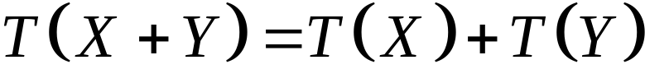


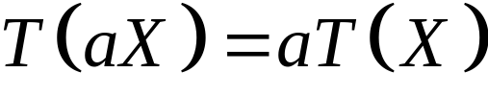


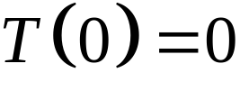
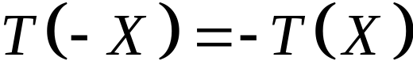
Definitions
5.1. Linear Transformations
A transformation is called a linear
Transformation if it satisfies:
1. for all vectors and
2. for all vector and all scalar
Note:
If is a linear transformation then
1.
2.

Slide 4

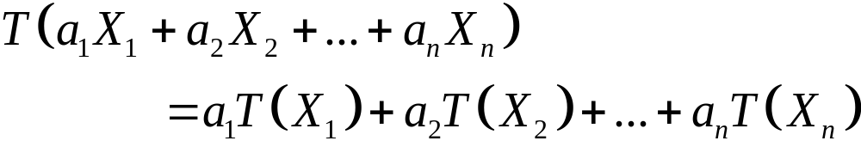


5.1. Linear Transformations
Theorem 1:
If is linear transformation, then
for all vectors , and all scalar

Slide 5

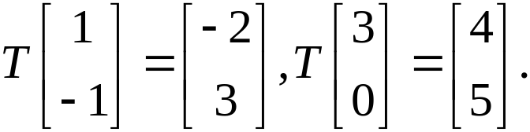
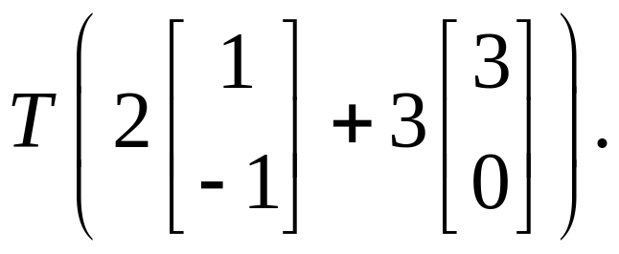
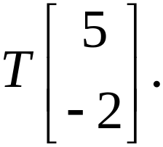
5.1. Linear Transformations
Example 1:
Let be linear transformation such that
Find:
a/
b/

Slide 6
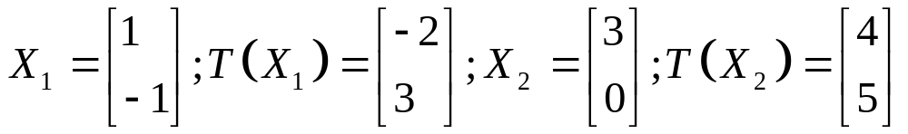
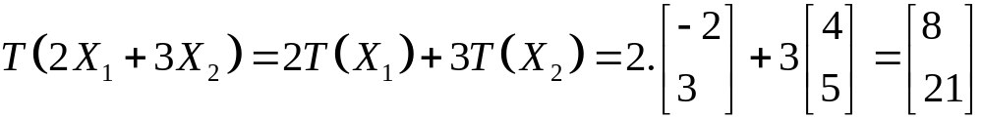
5.1. Linear Transformations
Solution:
a/ We have:
So,

Slide 7
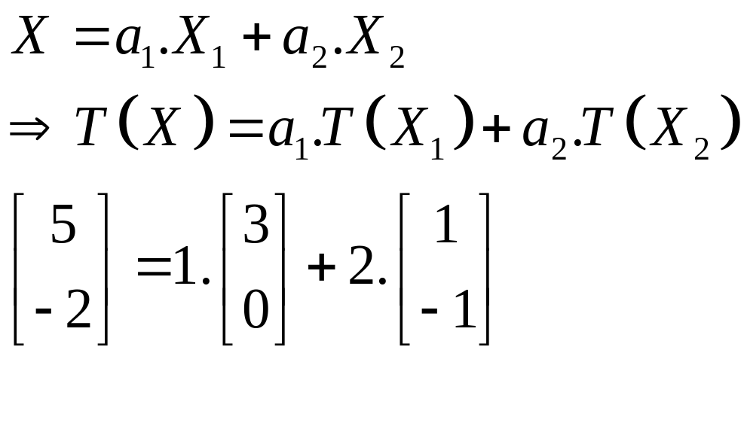
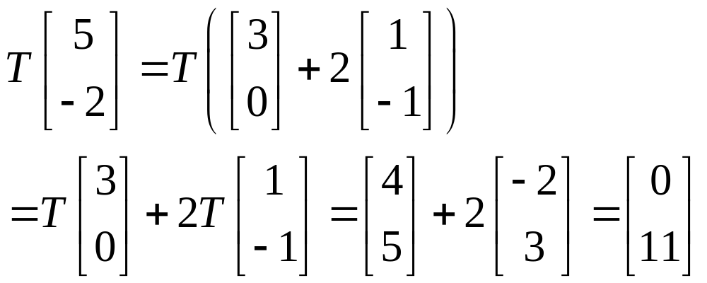
5.1. Linear Transformations
Solution:
b/ We have:
So,

Slide 8
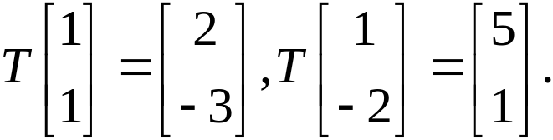
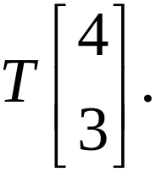
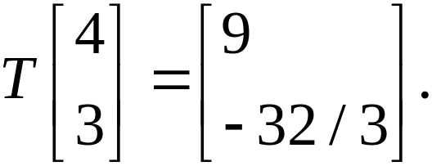
5.1. Linear Transformations
Example 2:
Let be linear transformation such that
Find
Answer:

Slide 9

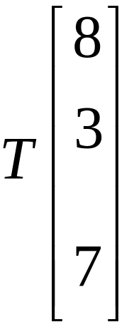
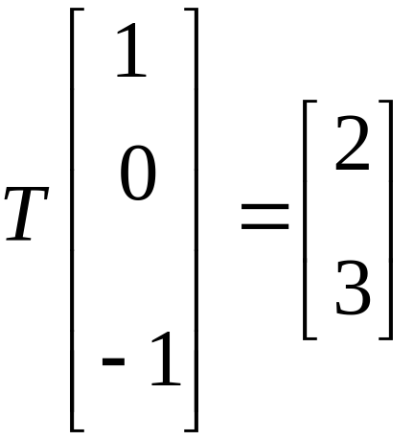
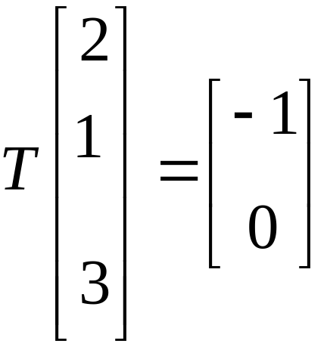
5.1. Linear Transformations
Example 3:
Let be a linear transformation
a/ Find if and
Notes:
Ans: [1 6]

Slide 10
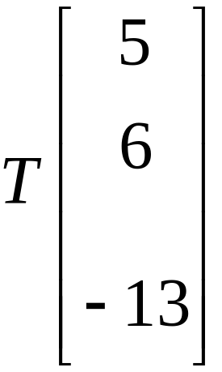
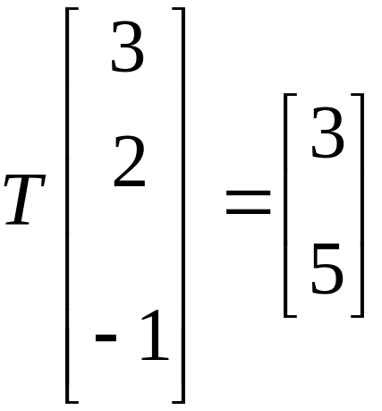
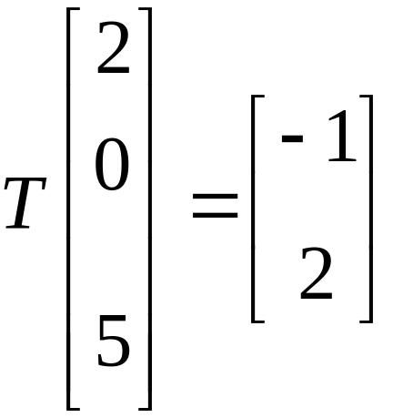
5.1. Linear Transformations
Example:
Let be a linear transformation
b/ Find if and
Notes:
Ans: [11 11]

Slide 11

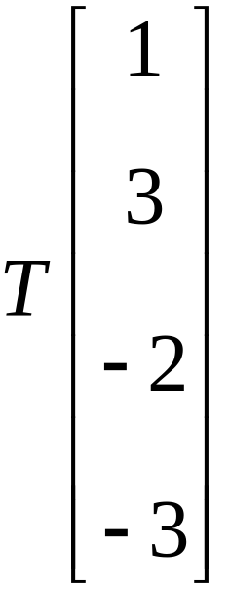
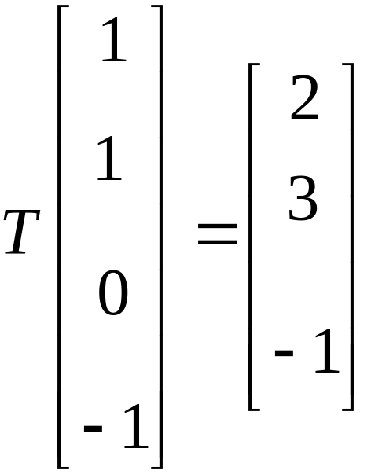
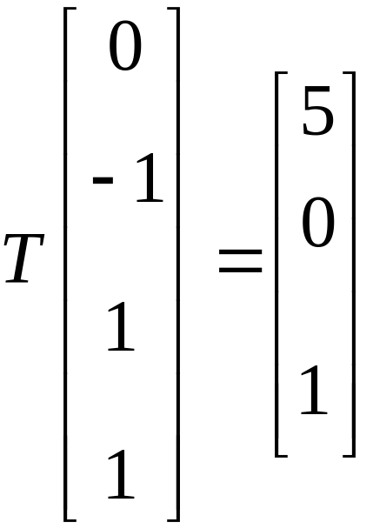
5.1. Linear Transformations
Example 4:
Let be a linear transformation
Find if and
Notes:
Ans: [ -8 3 -3]

Slide 12


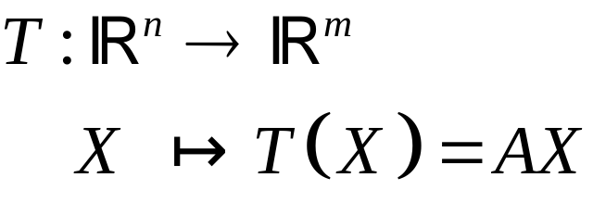


Formula of the linear transformation
5.1. Linear Transformations
Suppose is an matrix, the matrix transformation
then
is a linear transformation.
A is zero matrix: the zero transformation
A is identity matrix I_{n}: the identity transformation

Slide 13
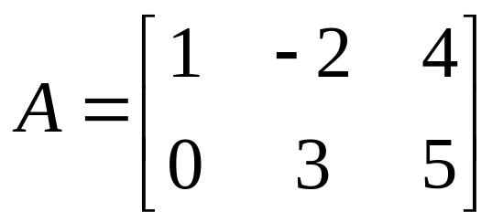
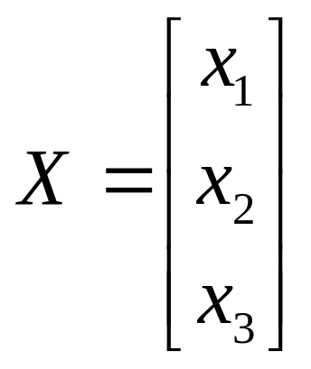
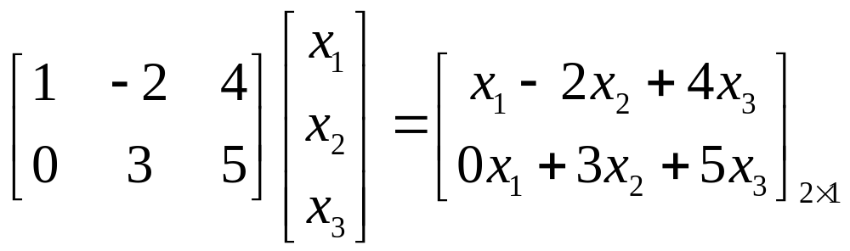
Example:
5.1. Linear Transformations
T(X)=AX

Slide 14

How to find the matrix of an linear transformation ?
5.1. Linear Transformations
Theorem 2.
Let T: R^{n} R^{m} be a transformation
a/ T is linear if it is a matrix transformation
b/ If T is linear, then T is induced by a unique matrix A, given in terms of its columns by A=[T(E₁) T(E₂) … T(E_{n})] where E₁, E₂,…, E_{n} is the standard basis of R^{n}

Slide 15
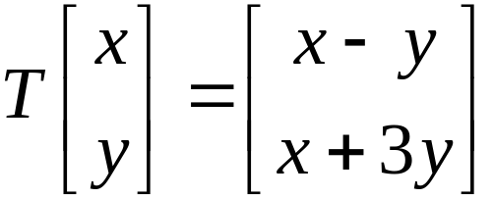

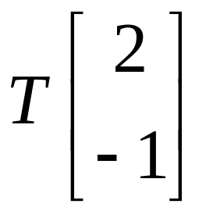
5.1. Linear Transformations
Example:
Let be linear such that
a/ Find the matrix of
b/ Find

Slide 16
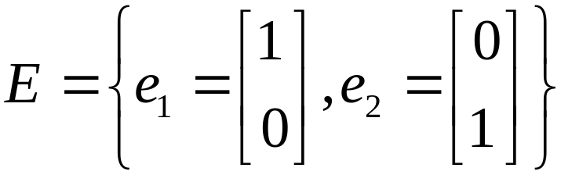

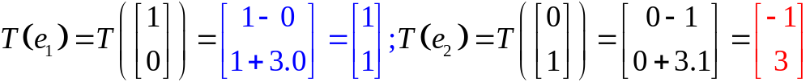
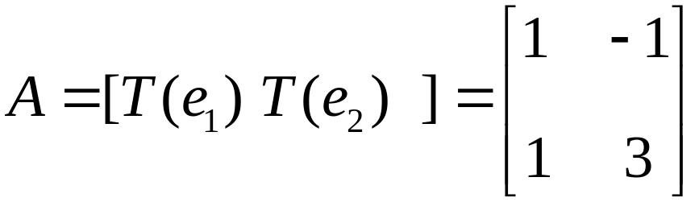
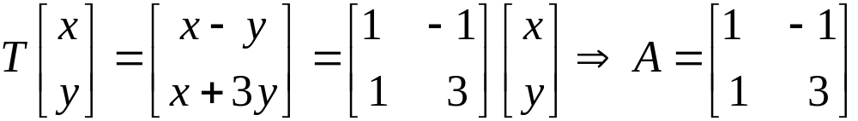
Solution:
5.1. Linear Transformations
a/ is standard basis of .
Method 2:

Slide 17
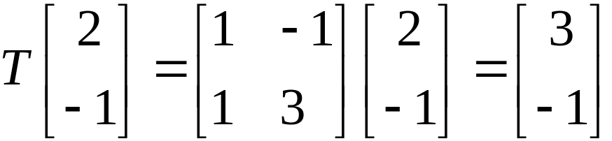
Solution:
5.1. Linear Transformations
b/

Slide 18

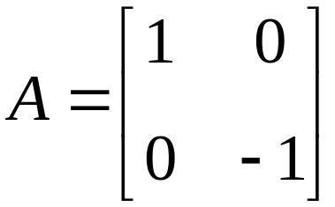
5.1. Linear Transformations
Example 3:
Conider the geometrical transformation of given by reflection in the axis. Find the matrix of a linear transformation.
Answer:

Slide 19
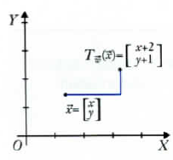
5.1. Linear Transformations
There are transformation that are not matrix transformations
Example:
The translation ( phép tịnh tiến) is not a matrix transformation.
A fixed vector
X
T
X+Y
A fixed vector
The matrix does not exist if Y is not zero vector

Slide 20


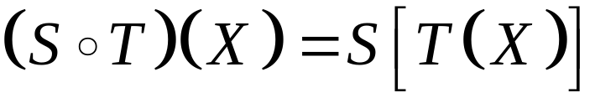
5.1. Linear Transformations
Composition
and
The composite of S and T is a transformation defined by for all vector X in R^{n.}
Theorem 3:
If T and S are linear then S°T is also linear. And if S has matrix B and T has matrix A, then S°T has matrix B.A
Transformation
S
T
S°T
Matrix
B
A
B.A

Slide 21
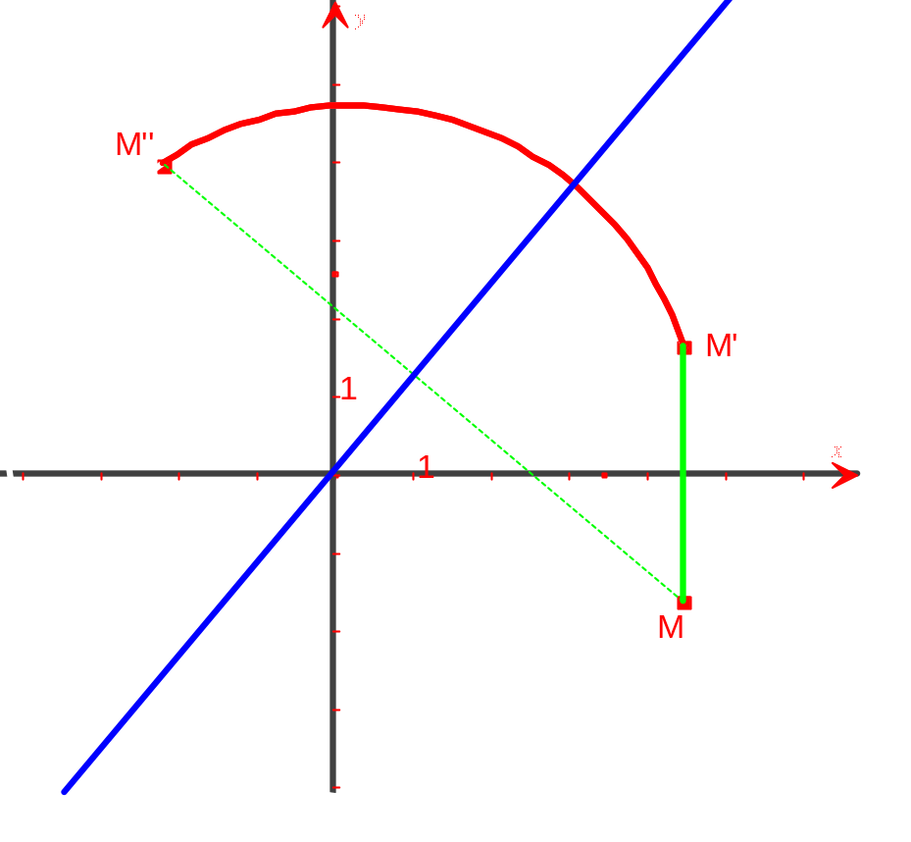
5.1. Linear Transformations
Example:
The reflection in the x-axis followed by rotation through pi/2 is reflection in the line y = x.

Slide 22

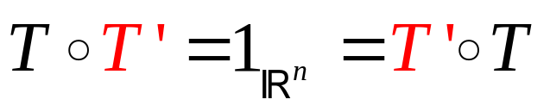
Inverse
5.1. Linear Transformations
Let is a transformation that has matrix A.
Suppose A is invertible then there exist A⁻¹
Let T’:R^{n}→R^{n} is a transformation that has matrix A⁻¹
i/ T’[T(X)]=A⁻¹[AX]=IX=X
ii/ T[T’(X)]=A[A⁻¹X]=IX=X
Then:
T’ is called an inverse of T if

Slide 23
5.1. Linear Transformations
Theorem 4:
Let denote a linear transformation with matrix
A.Then A is invertible if and only if T has an inverse.
In this case, T is has exactly one inverse.
( which we denote as T⁻¹and T⁻¹ has matrix A⁻¹ ),
T
matrix A
X Y
X Y
T⁻¹
matrix A⁻¹

Slide 24
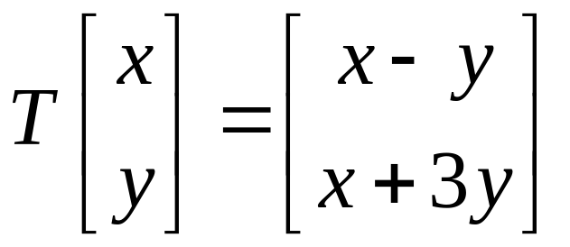

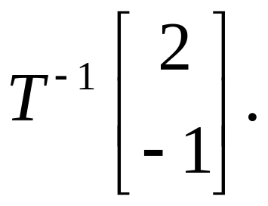
5.1. Linear Transformations
Example:
Let be a linear such that
Find

Slide 25
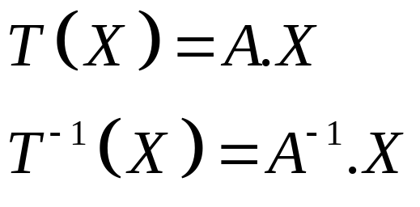
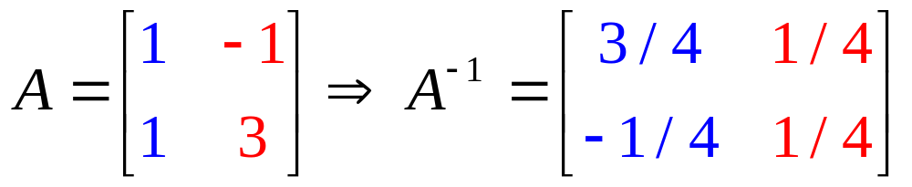
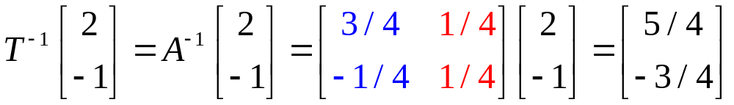
5.1. Linear Transformations
Solution:

Slide 26

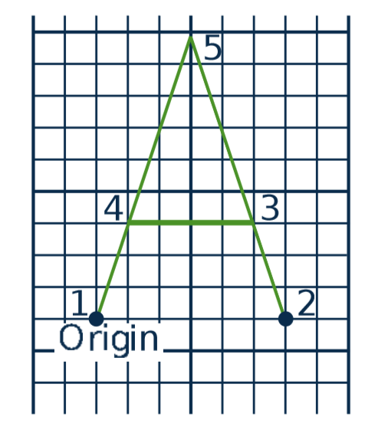
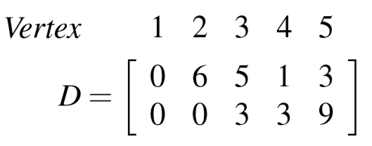
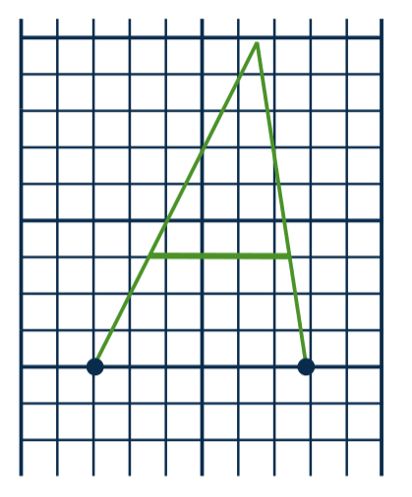
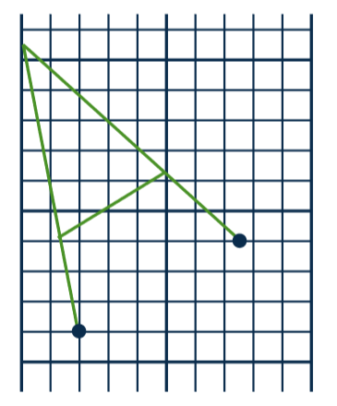
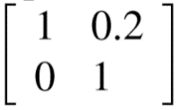




5.2. An application in Computer Graphics
How to change image?
Data matrix D
D

Slide 27

Computer graphics
5.1. Linear Transformations
Image matrix D
Matrices of transformations A₁, A₂, ..., A_{n}
Compute A_{n}...A₃A₂A₁D
3rd transformation
1st transformation
Data matrix
n^{th} transformation
2nd transformation

Slide 28



5.2. An application in Computer Graphics
Some common transformations and their matrices
Rotations
Theorem 1:
The rotation is the linear transformation
with the matrix

Slide 29









5.2. An application in Computer Graphics
Some common transformations and their matrices
Theorem 2:
The line through the origin with slope has equation , and we let denote reflection in the line
Theorem 3:
Let be projection on the line . Then
is a linear transformation with matrix

Slide 30








5.2. An application in Computer Graphics
Some common transformations and their matrices
Let denote the line through the origin in with direction
vector . Then and are both linear and

Slide 31


5.2. An application in Computer Graphics
Example :
In each case solve the problem by finding the matrix of the operator.
a/ Find the reflection of in the line with
equation
Notes:
Ans: Q=1/6[ -4,2,-4; 2,-4,-4;-4,-4,2] =[ 1 -2 -5].

Slide 32

5.2. An application in Computer Graphics
Example :
In each case solve the problem by finding the matrix of the operator.
a/ Find the reflection of in the line with
equation
Notes:
Ans: Q=1/6[ -4,2,-4; 2,-4,-4;-4,-4,2] =[ 1 -2 -5].

Slide 33


5.2. An application in Computer Graphics
Example:
In each case solve the problem by finding the matrix of the operator.
b/ Find the projection of on the line with
equation

Slide 34

5.2. An application in Computer Graphics
Example:
In each case solve the problem by finding the matrix of the operator.
b/ Find the projection of on the line with
equation

Slide 35






5.2. An application in Computer Graphics
Some common transformations and their matrices
Let denote the plane through the origin in with normal
vector . Then and are both linear and

Slide 36



5.2. An application in Computer Graphics
Example:
In each case solve the problem by finding the matrix of the operator.
a/ Find the projection of on the plane with
equation
b/ Find the reflection of in the plane with
equation

Slide 37

5.2. An application in Computer Graphics
Example:
In each case solve the problem by finding the matrix of the operator.
a/ Find the projection of on the plane with
equation

Slide 38

5.2. An application in Computer Graphics
Example:
In each case solve the problem by finding the matrix of the operator.
b/ Find the reflection of in the plane with
equation

Slide 39








5.2. An application in Computer Graphics
Some common transformations and their matrices
Let denote rotation of about the axis
through an angle from the positive axis toward the positive y axis. has matrix

Slide 40


5.2. An application in Computer Graphics
Example:
Find the rotation of about the z-axis
through .

Slide 41

5.2. An application in Computer Graphics
Example:
Find the rotation of about the z-axis
through .

